Slide 1
Fraudulent Product Detection Using Customer Reviews and Ratings on Amazon Product Data
Zeroth Review
Under the Guidance of:
Ms. T. Sindhu
Presented by:
Palanivelrajan P,
2019202039,
MCA(Regular)2019-22

Slide 2
Introduction
In recent years, Customers buy a lot of products on online which leads to increased rate in online fraud activities. Many fraud and defective products are sold online even on very known eCommerce platforms^{[7]}.
Shopclues is a ecommerce platform valued over $1.1B dollars in 2016 but due to increased sales of fake products and lack of tech commitment, the company failed and just sold for $70M^{[6]}.
Several machine learning algorithms are developed over the years with an increasing trend in anomaly detection techniques. These techniques can be utilized to intimate the upcoming buyer that there is a possibility of buying a low-quality or fraudulent product from the seller.
Clustering and classification of product information empower the end customer to identify counterfeits accurately and efficiently by comparing them with trained models.

Slide 3
Objective
To recognize the sentiments from the review texts.
To identify outlier nodes/ biased reviews.
To calculate the fraudulent score of the product from its loyal product reviews.

Slide 4
Dataset Description
Types of dataset:
5-Core product data for clothing, shoes and jewelry products:
Products with minimum 5 reviews are defined as 5-core product data^{[4]}.
Contains clothing, shoes and jewelry products reviews (2.78M Reviews for 23K Products)^{[4]}.
Meta product data:
It is the description off the products with their basic details like product name, product price, sales rank, also bought, also viewed etc… (23K Products)^{[4]}.
Input format: csv file (5-Core product and Meta product table Combined)
Output format: Fraudulent Score for each product

Slide 5
Problem Statement
One of the main problems is selling low-quality products, Customers can’t able to find good products in the market.
Customers write a lot of reviews these days about the product qualities. One important factor is to identify the helpful reviews and with Only those reviews and ratings from previous users of the product can give a hint about the quality of the product.

Slide 6
Proposed System
To preprocess the data elements and remove unwanted features.
To analyse sentiments on the review texts and convert these reviews into labels.
To create a graph representation of the products, and biased dense nodes are removed. By doing this Only reviews from loyal users are collected and processed. This will avoid biased reviews based on incidents like a customer targeting only a particular seller, the user who always gives negative reviews without buying a product, and users who give highly positive reviews for a particular seller there is a possibility that both seller and user are same.
To calculate the fraudulent score for each product.

Slide 7
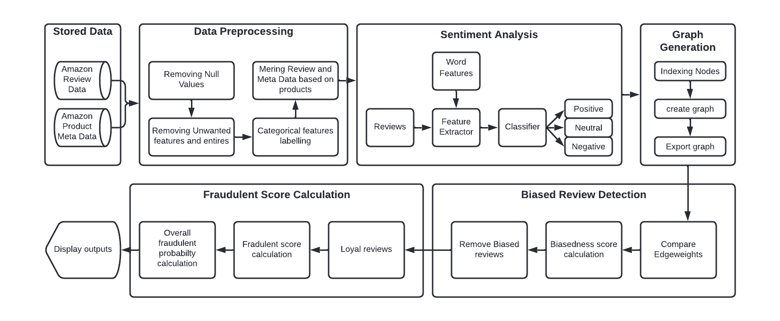
Architecture Diagram

Slide 8
Module Description
Data Preprocessing:
This Module is a Data Cleaning where Null values are removed, Unwanted features are removed and categorical features will be labeled.
There is a feature named helpfulness score for the review given in the dataset. Unwanted reviews are those reviews which are not helpful are removed.
Finally the Review Data with the product ID will be mapped with the product ID in meta data and all the features are combined into a single dataset.
Data preprocessing
Sentiment Analysis on reviews
Graph Generation
Biased Reviews Detection
Fraudulent Score Calculation

Slide 9
Module Description
Sentiment Analysis on reviews:
In the preprocessed data we have a feature column ‘review text’ which contains the customer reviews for the products.
To analyse the sentiment of the reviews a customer sentiment analysis function is implemented. These sentiments will be either ‘positive’ or ‘negative’ or ‘neutral’ class^{[5]}.
Sentiment score for positive is 2, neutral is 1 and for negative is 0.
Data preprocessing
Sentiment Analysis on reviews
Graph Generation
Biased Reviews Detection
Fraudulent Score Calculation

Slide 10
Module Description
Graph Generation:
The need for graph generation arised due to the scale of the data and its domain^{[1]}.
The relation between product and customer is a bipartite relationship, no two products are related and no two users are related. Graph representation are the fastest way to interpret these type of data^{[2]}.
The preprocessed and sentiment analyzed data points are then converted into a weighted directed bipartite graph.
First set is the Product ID and second set is the Reviewer ID. If a product is reviewed by a user then there is an edge between these two nodes and their corresponding sentiment score, ratings {W = <S,R>} will be the Edgeweight
Data preprocessing
Sentiment Analysis on reviews
Graph Generation
Biased Reviews Detection
Fraudulent Score Calculation
Product Set
Reviewer Set
P1
P2
P3
.
.
Pn
W₁₁
R1
R2
R3
.
.
Rn
W₁₂
W₂₃
W_{2n}
W₁₁ -> Weight of reviewer 1 product 1

Slide 11
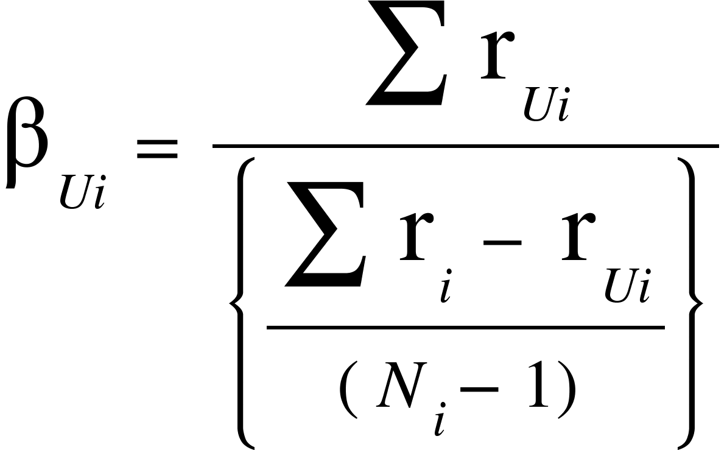
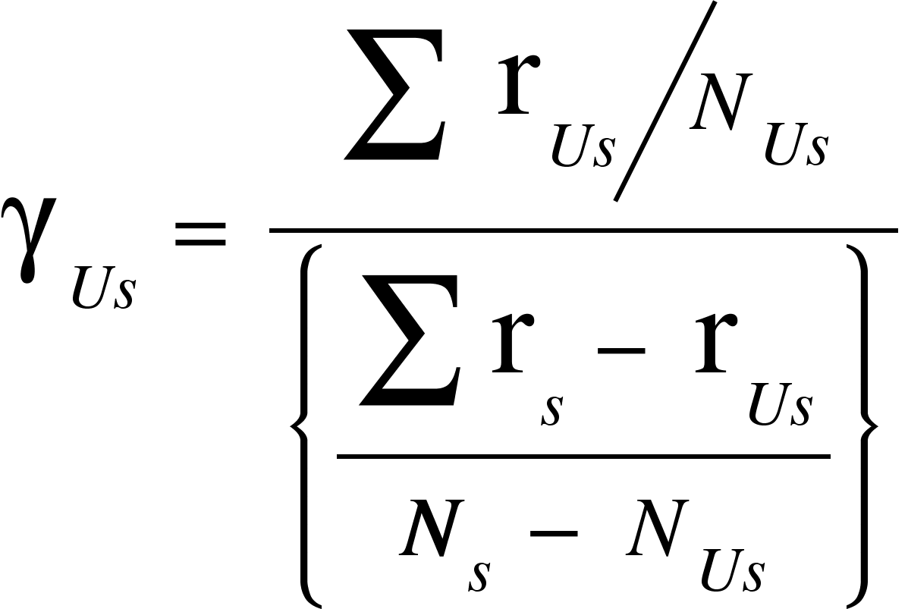
Module Description
Biased Reviews Detection:
Reviewers with biased reviews can create a greater impact while buying. These biased reviewers should be identified and reviews given by them are removed.
A Biasedness score (β) is calculated for each reviewer per product
A Biasedness score (ɣ) is calculated for each reviewer per seller
Data preprocessing
Sentiment Analysis on reviews
Graph Generation
Biased Reviews Detection
Fraudulent Score Calculation
Where,
β_{Ui} Biasedness score of user(U) for product(i)
r_{Ui} Ratings by user(U) for product(i)
r_{i} Ratings for product(i)
N_{i} Number of ratings for product(i)
Where,
ɣ_{Us} Biasedness score of user(U) for seller(s)
r_{Us} Ratings by user(U) for seller(s)
r_{s} Ratings for seller(s)
N_{s} Number of ratings for seller(s)
N_{Us} Number of ratings by user(U) for seller(s)

Slide 12
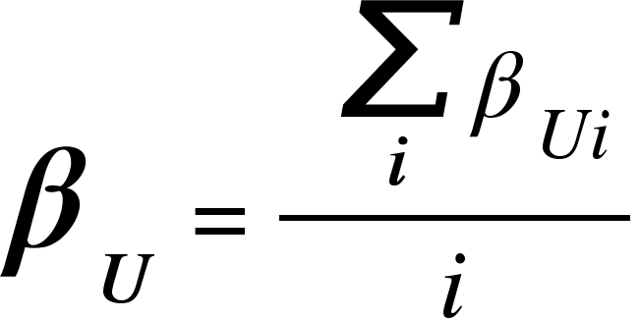
Module Description
There are 4 main categories for biased reviews we are concentrating for now,
Type 1 - User will always give a positive review, ratings for all the products bought irrespective of its quality.
Type 2 - User will always give a negative, ratings review for all the products bought irrespective of its quality.
Data preprocessing
Sentiment Analysis on reviews
Graph Generation
Biased Reviews Detection
Fraudulent Score Calculation
Where,
β_{U} Combined Biasedness score of user(U)
β_{Ui} Biasedness score of user(U) for product(i)
i Number of product(i)
Product Set
Reviewer Set
Product Set
Reviewer Set
P1
P2
P3
.
.
Pn
<2,5>
<2,5>
<2,5>
R1
R2
R3
.
.
Rn
P1
P2
P3
.
.
Pn
R1
R2
R3
.
.
Rn
<0,1>
<0,1>
<0,1>
Where,
<2,5> = <positive review, max rating> ∀ products reviewed by User 1
Where,
<0,1> = <negative review, min rating> ∀ products reviewed by User 1
Potentially Biased Reviewer - R1
A value of 0.25 is set as threshold limit, If the β_{U} of user is lesser than the threshold then the user is potentially a biased reviewer.

Slide 13
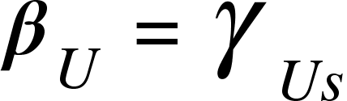
Module Description
Type 3 - User will give positive reviews, ratings for all the products bought from a specific seller.
Type 4 - User will give negative reviews, ratings for all the products bought from a specific seller.
Data preprocessing
Sentiment Analysis on reviews
Graph Generation
Biased Reviews Detection
Fraudulent Score Calculation
Where,
β_{U} Combined Biasedness score of user(U)
ɣ_{Us} Biasedness score of user(U) for seller(s)
Product Set
Reviewer Set
Product Set
Reviewer Set
P1
.
P2
.
P3
.
Pn
R1
R2
R3
.
.
Rn
P1
.
P2
.
P3
.
Pn
R1
R2
R3
.
.
Rn
<2,5>
<2,5>
<2,5>
<0,1>
<0,1>
<0,1>
Where,
P1.X == P2.X == P3.X
X - Seller
Where,
P1.X == P2.X == P3.X
X - Seller
Potentially Biased Reviewer - R1
A value of 0.25 is set as threshold limit, If the β_{U} value is lesser than the threshold then the user is potentially a biased reviewer.

Slide 14
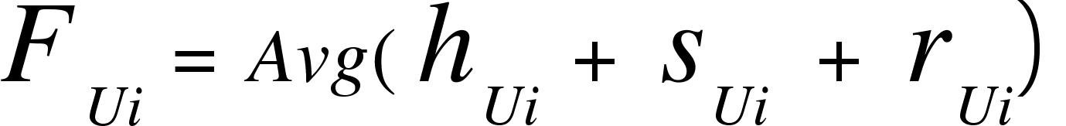
Module Description
Fraudulent Score Calculation:
Unbiased and Helpful reviews are given as input to this module. These reviews are considered as loyal reviews.
Fraudulent score (F) will be calculated for each product based on the helpfulness score, sentiment score and ratings.
Based on the fraudulent score, the probability of a product being a ‘good’ or ‘bad’ can be calculated and known by the future buyers or the platform owner.
Overall fraudulent score for a product is the average of all the fraudulent score for the given product by all the users.
Data preprocessing
Sentiment Analysis on reviews
Graph Generation
Biased Reviews Detection
Fraudulent Score Calculation
Where,
F_{Ui} Fraudulent score for product(i) by user(U)
h_{Ui} Helpfulness score for product(i) by user(U)
s_{Ui} Sentiment score for product(i) by user(U)
r_{Ui} Ratings for product(i) by user(U)

Slide 15
Advantages
This can potentially stop a fraud seller from selling the products online.
It will give an option to the customers whether to buy the product by giving them information about the product’s quality.
It will also help the ECommerce platform to detect sellers with low-quality products and increase their customer quality experience.

Slide 16
References:
Base Paper: Li, A., Qin, Z., Liu, R., Yang, Y. and Li, D., 2019, November. Spam review detection with graph convolutional networks. In Proceedings of the 28th ACM International Conference on Information and Knowledge Management (pp. 2703-2711).
[1] T. U. Haque, N. N. Saber and F. M. Shah, "Sentiment analysis on large scale Amazon product reviews," 2018 IEEE International Conference on Innovative Research and Development (ICIRD), 2018, pp. 1-6, doi: 10.1109/ICIRD.2018.8376299.
[2] Akoglu, L., McGlohon, M., Faloutsos, C. (2010). oddball: Spotting Anomalies in Weighted Graphs. In: Zaki, M.J., Yu, J.X., Ravindran, B., Pudi, V. (eds) Advances in Knowledge Discovery and Data Mining. PAKDD 2010. Lecture Notes in Computer Science(), vol 6119. Springer, Berlin, Heidelberg. https://doi.org/10.1007/978-3-642-13672-6_40
[3] Zhangyu Cheng, Chengming Zou, and Jianwei Dong. 2019. Outlier detection using isolation forest and local outlier factor. In Proceedings of the Conference on Research in Adaptive and Convergent Systems (RACS '19). Association for Computing Machinery, New York, NY, USA, 161–168. DOI:https://doi.org/10.1145/3338840.3355641
[4] https://jmcauley.ucsd.edu/data/amazon/
[5] https://towardsdatascience.com/step-by-step-twitter-sentiment-analysis-in-python-d6f650ade58d
[6]https://www.businessinsider.in/business/startups/news/shopclues-sold-heres-a-timeline-of-how-the-unicorn-startup-went-down/articleshow/71847099.cms
[7] https://www.statista.com/statistics/792047/india-e-commerce-market-size/

Slide 17
Thank you

